Slide 1

Safely Evolving Legacy Code
Slides up at scottsauber.com
scottsauber

Slide 2

Audience
Anyone with legacy code at their job
Anyone searching for a better way than The Great Rewrite™
scottsauber

Slide 3
Goals
Give you ideas on how you can safely work with legacy code today
This is not about how to completely rewrite legacy code, it’s about evolving
scottsauber

Slide 4
Agenda
What is Legacy Code
Making changes today to Legacy Code
Add safety nets around Legacy Code
How this worked in practice
scottsauber

Slide 5

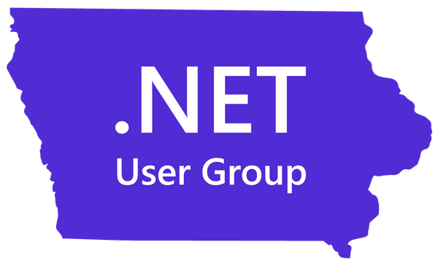
Who am I?
Director of Engineering at Lean TECHniques
Co-organizer of Iowa .NET User Group
Friend of Redgate
Blog at scottsauber.com
scottsauber

Slide 6
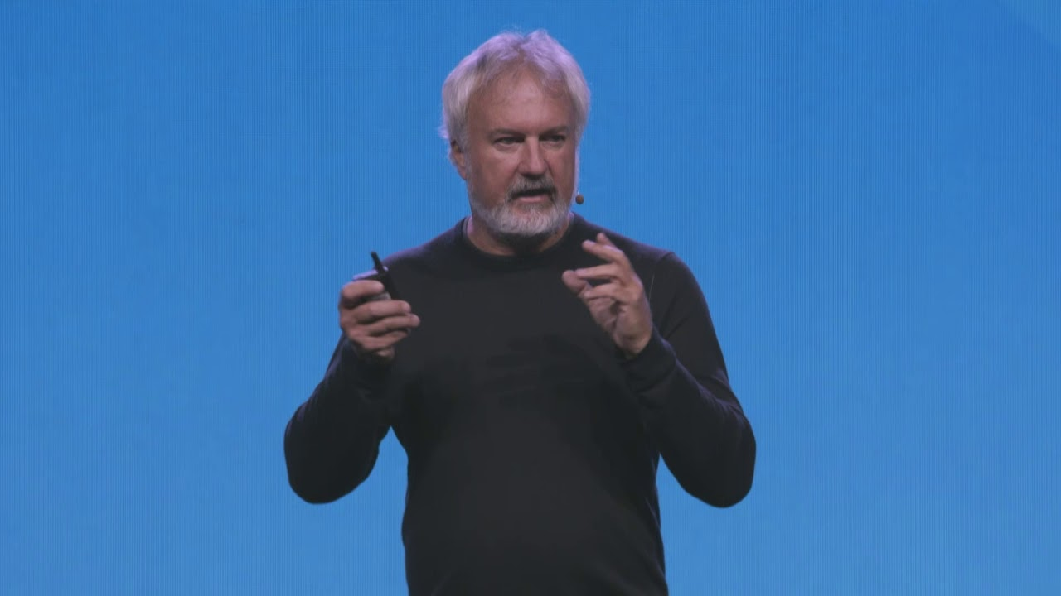
“Legacy Code is code without tests”
Michael Feathers

Slide 7
Characteristics of Legacy Code
Hard to understand
Changing code often results in breaking the app in unexpected ways
Long cycle times to add or change functionality
Huge estimates for seemingly small changes
Stories seemingly drag on across days, weeks, months
3rd party reviews
scottsauber

Slide 8
I need to make a change to “that app”…

Slide 9
3 options when changing legacy code
Edit and Pray
Rewrite
Cover and Modify
scottsauber

Slide 10
Question to ask yourself: How much time do we have?

Slide 11
I need to add new functionality today
Find seams into existing code
Make minimal changes to untested code with one of two techniques
Sprout
Wrap
Avoid adding “just a few more lines” to the god classes/functions
We should not refactor without existing tests in place
scottsauber

Slide 12

Sprout

Slide 13
Sprout
Create new method/function/class to house new behavior
TDD the new behavior
Insert new, tested code into existing code (existing code untested)
In the case of .NET, you can call C# from VB
scottsauber

Slide 14
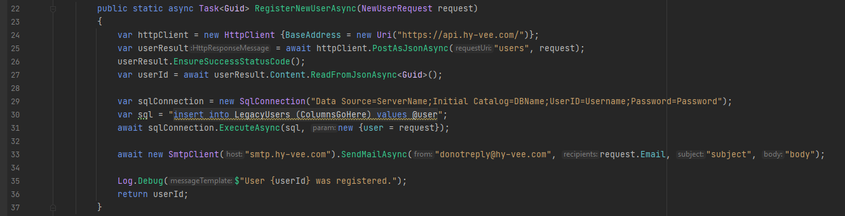
Sprout Example – Existing Code

Slide 15
Requirement! Do not allow an invalid email address to be registered

Slide 16
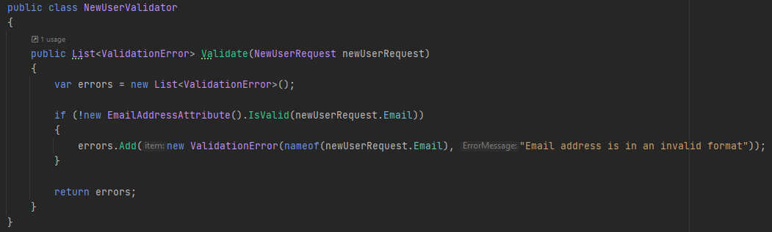
Sprout Example – New Code Tested in Isolation

Slide 17
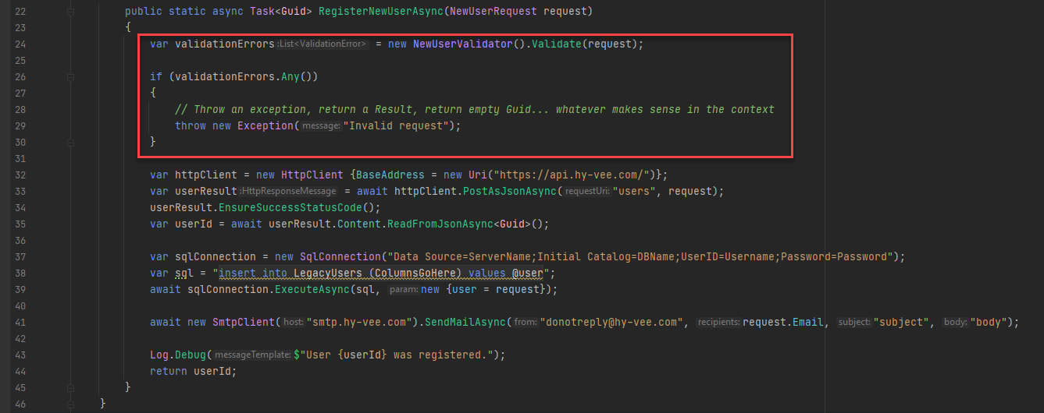
Sprout Example – Sprout into Existing Code

Slide 18

Wrap

Slide 19
Wrap
Works if the new code needs to be added at the beginning or end of a method
Extract all existing code into another method
Called newly extracted method from the original method
Insert new code before/after the extracted method
Can lead to awkward naming during extract method process
scottsauber

Slide 20
Wrap Example – Existing Code

Slide 21
Requirement! Do not allow an invalid email address to be registered

Slide 22
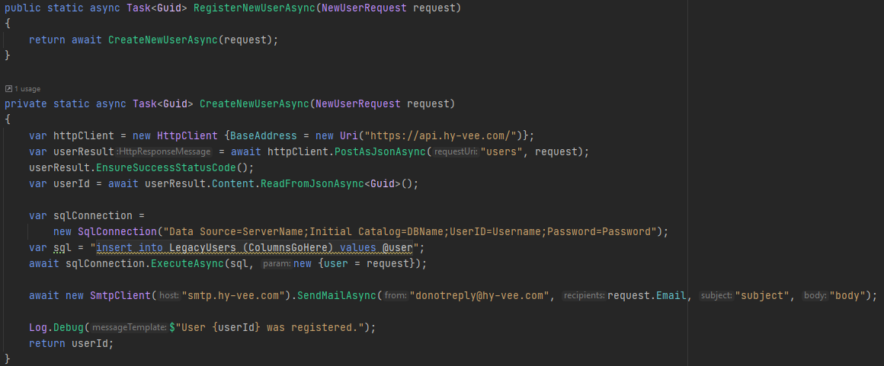
Wrap Example – 1. Extract Method

Slide 23
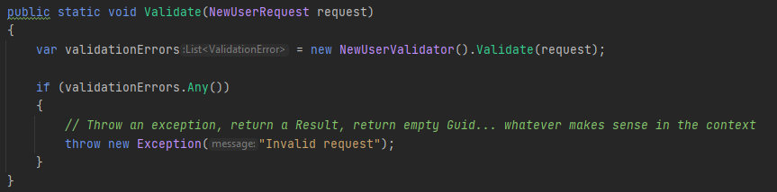
Wrap Example – 2. Create/Test New Method(s)

Slide 24
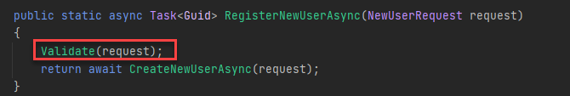
Wrap Example – 3. Call From Original Method

Slide 25
When to use Sprout vs Wrap
When you need to make a change today to existing code, no time to add tests around the app as a whole
Very close to the same when the code to add is at the beginning or end
Wrap promotes testing more control flow into the existing code
Throwing the exception is easier to test in isolation
Cannot easily use Wrap to plug into the middle of a method, must use Sprout
scottsauber

Slide 26
Questions about Sprout or Wrap?

Slide 27
We Have Time How Do We Evolve Legacy Code?

Slide 28
Avoid The Big Rewrite when possible
The Big Rewrite is one of the most expensive and risky decisions we can make without proper understanding of the current system
Delays new feature development
No iterative steps
Without tests around the existing system, you are essentially “Editing and Praying”
Don’t try to rewrite the entire app
Carve off parts of the app to rewrite
scottsauber

Slide 29
Avoid The Big Rewrite when possible
…but before you carve off, understand your current system first
Can’t properly rearchitect without understanding the current system
I am usually not a fan of moving the app logic and changing database schema at the same time
It depends
scottsauber

Slide 30
How do I evolve existing Legacy Code?
Understand what the app does
Add characterization/integration tests around existing code
Refactor the code
scottsauber

Slide 31
1. Understand the app
Add logging
Add metrics
Add instrumentation
Observe application in Production
Read the code and take notes
Refactor without tests but throw away when done
scottsauber

Slide 32
2. Add characterization/integration tests
After understanding the inputs and outputs, you can now add tests
Completely blackbox the implementation code as much as possible
Need safety net when you refactor in the next step
Paradox!
I need to add tests so I can change the code, but I can’t test it without changing the code (i.e. Production hardcoded)
Make absolute minimum changes to allow app to be tested
scottsauber

Slide 33
3. Refactor the Code
After having the tests, now you can safely refactor
Make change, run tests, repeat
Get back to green as quickly as possible
Avoid “long red”
scottsauber

Slide 34

What did we actually do?

Slide 35
Disclaimer
The code I’m about to talk about is no one individual’s fault
Code is the product of an organization, not an individual
Time constraints
Technical constraints
Technical training
Allowing silos to form
scottsauber

Slide 36
What we’ve done
Nature of our work
Typical scenario for a team I was on:
Inherit existing codebase
Few, if any, domain experts left in company
Few, if any, tests. Zero integration tests
No Test Environment of any kind
Most of the time, no CI/CD Pipeline
Bulk of logic in SQL
Hardcoded Configuration
scottsauber

Slide 37
Backstory
80% of logic in SQL, 20% in C#
Regularly required 20+ off hours of support every week from Devs
End users unable to perform their job in a timely manner or effectively
scottsauber

Slide 38
Initially…
We tried to Edit and Pray
Always led to breaking the app in a new way
Slow feedback loop
ETL jobs only ran weekly
scottsauber

Slide 39
Step 1. Understand the application
Understand the purpose of the application
Understand the existing codebase
Created tools/metrics to measure the application did what we thought it did
Initially quick and dirty metrics
Now we have Grafana Dashboards
Add instrumentation to understand how it performs in Production
NewRelic
Pair Program
Doctors don’t perform surgery alone
scottsauber

Slide 40
Step 2a. Stabilize
Root caused issues and fixed
Avoided “extending the timeout”
On-call rotation to shield team from issues
scottsauber

Slide 41
Step 2b. Shorten feedback loop
Did the minimum to remove blockers for tests (no big refactor)
Created test environment in the cloud
Created Docker images of database scheme
Added integration tests
scottsauber

Slide 42
Step 3. Optimize Code
Added more New Relic instrumentation
Analyzed New Relic
Identified bottlenecks with New Relic
Optimizing code was now safe to make with integration tests in place
Added logging in some long stored procs for identifying bottlenecks inside stored procedures
Continue optimizing
scottsauber

Slide 43
Outcomes
ETL Process went from 40 hrs a week to 1 hr
Used to generate 20 hrs of off-hours support, now we usually forget about it
Users have confidence in the software
Code is easier to reason about, make changes
Code scales
Users reported longstanding bugs because they expect things to work now
scottsauber

Slide 44
Takeaways
Sprout and Wrap strategies for adding new, tested code to legacy apps
How to evolve legacy code without The Big Rewrite
Real life scenario of a plan to improve legacy code
Investment it takes to improve some of these applications
The payoff
scottsauber

Slide 45
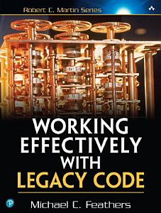

Resources
The Book
Working Effectively with Legacy Code by Michael Feathers
435 pages
https://understandlegacycode.com/
Refactoring: Improving the Design of Existing Code by Martin Fowler
This slide deck

Slide 46
Questions?

